Slide 1

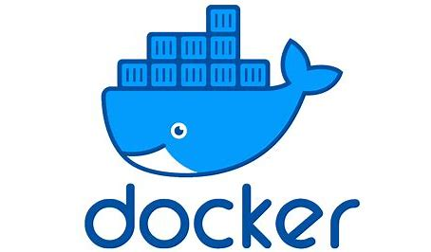
Startup & Entrepreneurship (a SHORT case study on Docker)
wtfashwin

Slide 2
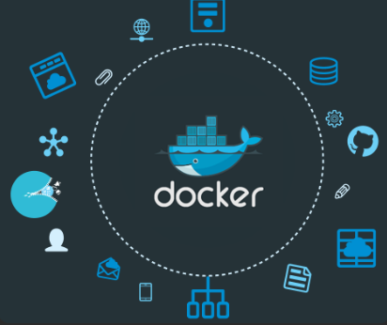
About
Docker is an open-source platform that uses containerization to package applications and their dependencies together.
It creates lightweight, portable, and self sufficient containers that can run consistently across different environments.
Build, ship, and run any app, anywhere.
Rise of Microservices : for which docker is perfect fit for deploying & managing them

Slide 3
The Problem
3
Problems
Environment Issues
Slow Deployment
Dependency Hell
Inefficient Resource Utilization
Scaling

Slide 4
Docker - The Solution
Containerization
01
Consistent Environments
02
Simplified Deployment
03
Improved Collaboration
04
Enhanced Scalability
05

Slide 5
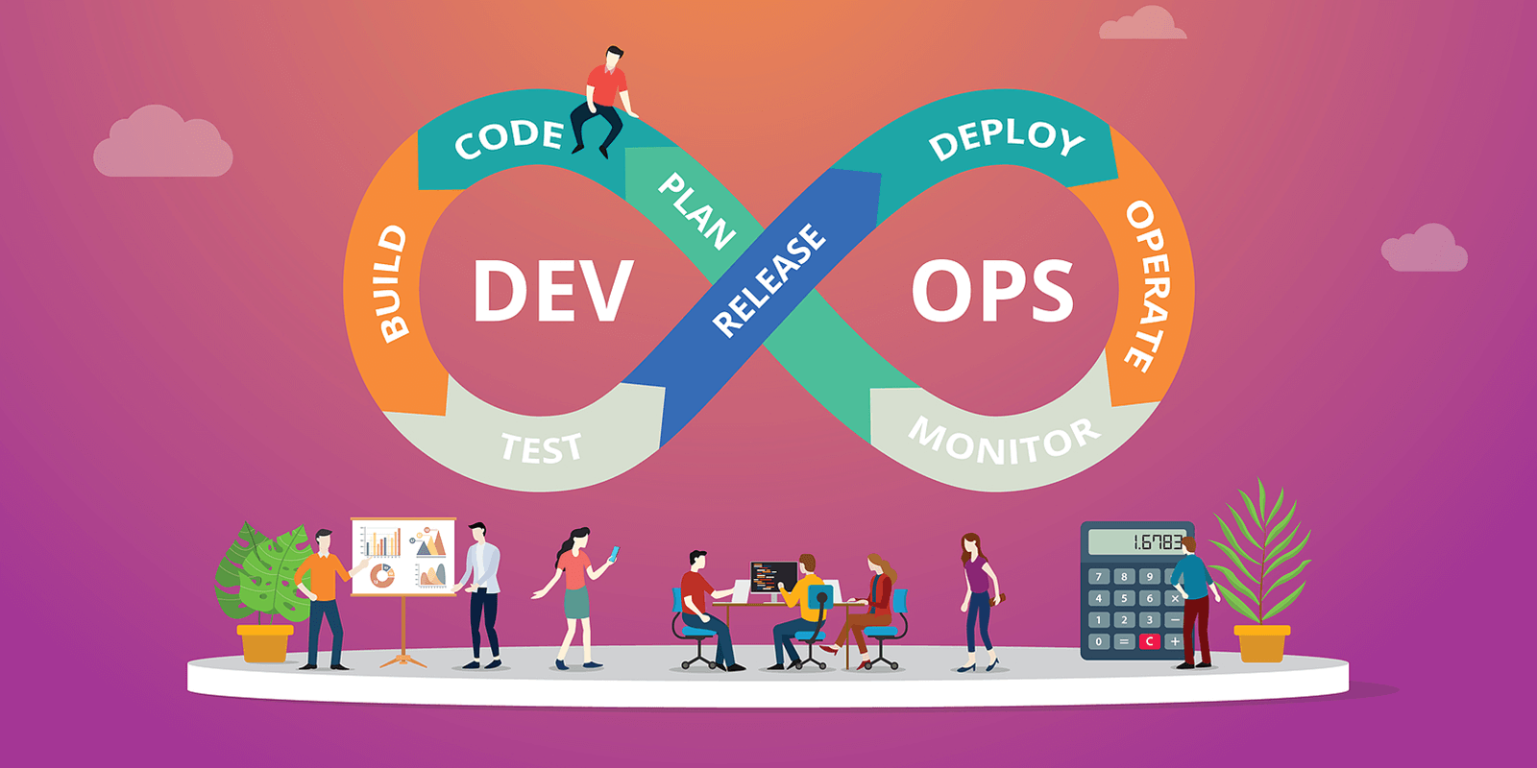


Market Size & Growth
Cite industry reports and statistics on the growing adoption of containerization and cloud technologies.
Target the entire software development ecosystem: developers, DevOps engineers, system administrators, and businesses of all sizes.
Emphasize the potential for long-term growth due to the increasing demand for agility and efficiency in software development.

Slide 6
Existing Alternatives
Virtual Machines
01
Traditional Deployment
02
Serverless Computing
04
Bare Metal Servers
03

Slide 7
Growth Strategy
Phase 1
Phase 2
Phase 3
Focus:
Market Penetration and Adoption
Community Building
Ecosystem Development:
Enterprise Outreach
Open-Source Advocacy
Focus:
Product Innovation and Expansion
Develop Advanced Features
Cloud Integration
Explore New Markets
Build Strategic Partnerships
Focus:
Sustainability and Long-term Growth
Maintain and Enhance Ecosystem
Focus on Innovation
Build a Strong Brand
Foster a Sustainable Business Model

Slide 8
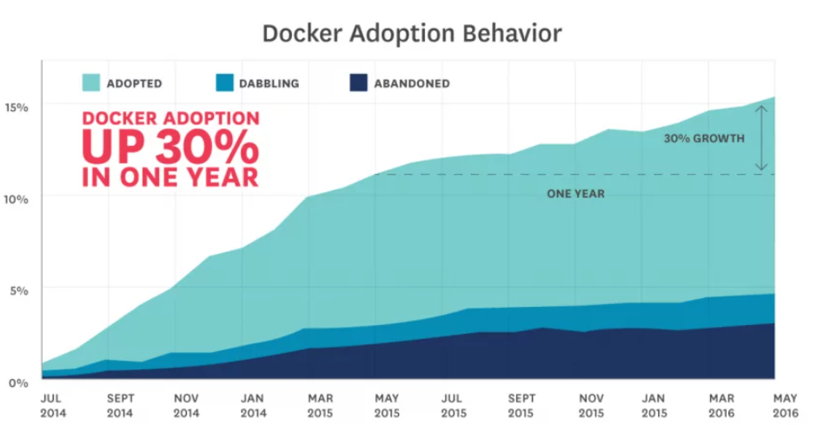

Slide 9
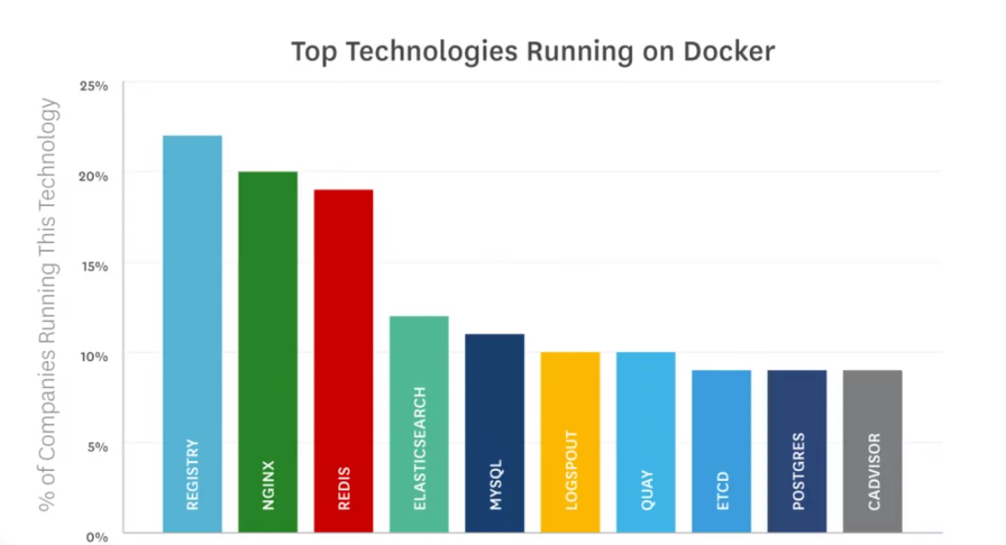

Slide 10
Willingness to Pay
Docker's Value Proposition:
Increased developer productivity.
Reduced time-to-market for new products and features.
Improved resource utilization and reduced infrastructure costs.
Enhanced operational efficiency and reduced downtime.
Willingness to Pay:
Customers are willing to pay a premium for tools that deliver significant business value.
Pricing models can include:
Subscriptions for enterprise customers.
Pay-per-use models for cloud-based services.
Open-source offerings with premium support options.

Slide 11
Customer Segments
Docker
Large Enterprises
SMB’s
Startup’s
Individual

Slide 12
Conclusion
Docker's Impact
Revolutionized the way applications are developed, deployed, and managed.
Empowered developers and DevOps teams to work more efficiently and effectively.
Driven significant innovation in the software development ecosystem.
Future of Docker:
Continued growth and evolution in the containerization space.
Expanding use cases and integration with other technologies.
Continued focus on addressing the evolving needs of customers.

